Slide 1
Phi-3 Classification
Angus Leung
2018-05-11

Slide 2
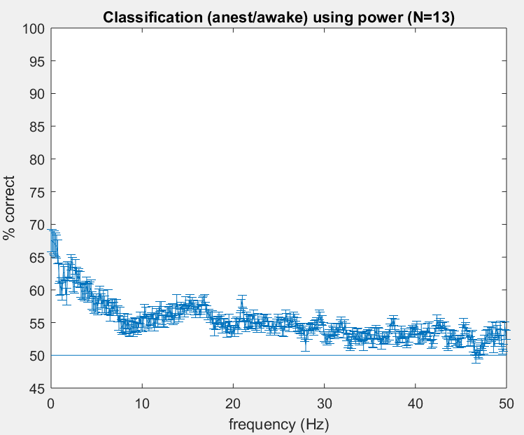
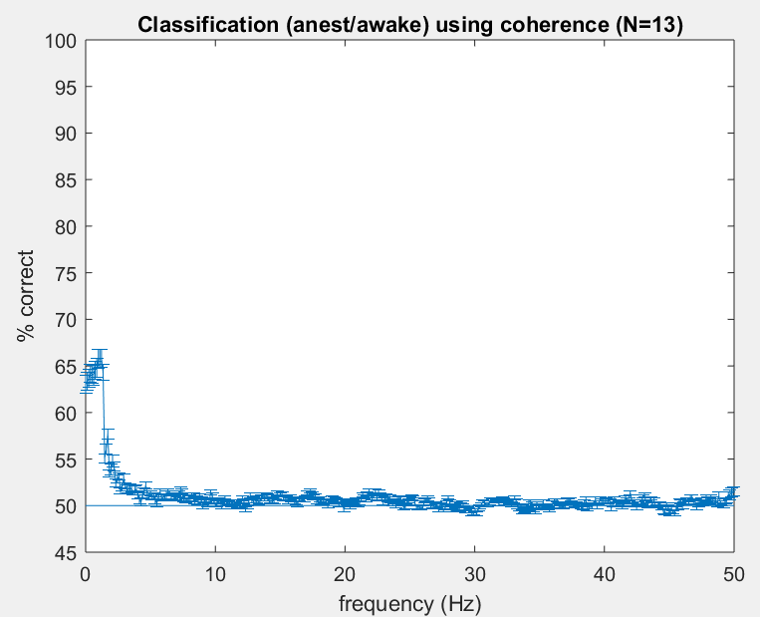
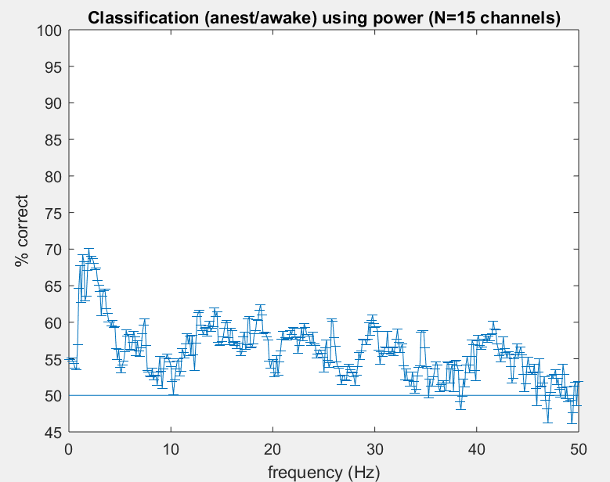
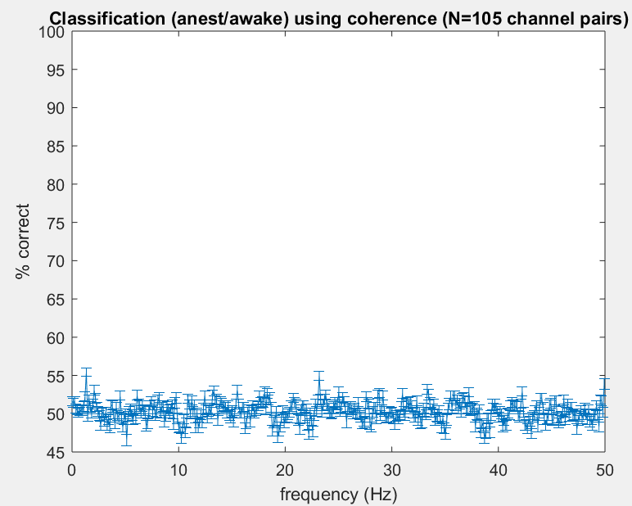
Notes:
FIGURE supp
limit y-axis 70-75%
Potential combine into 2 panel or 1 panel
patch

Slide 3
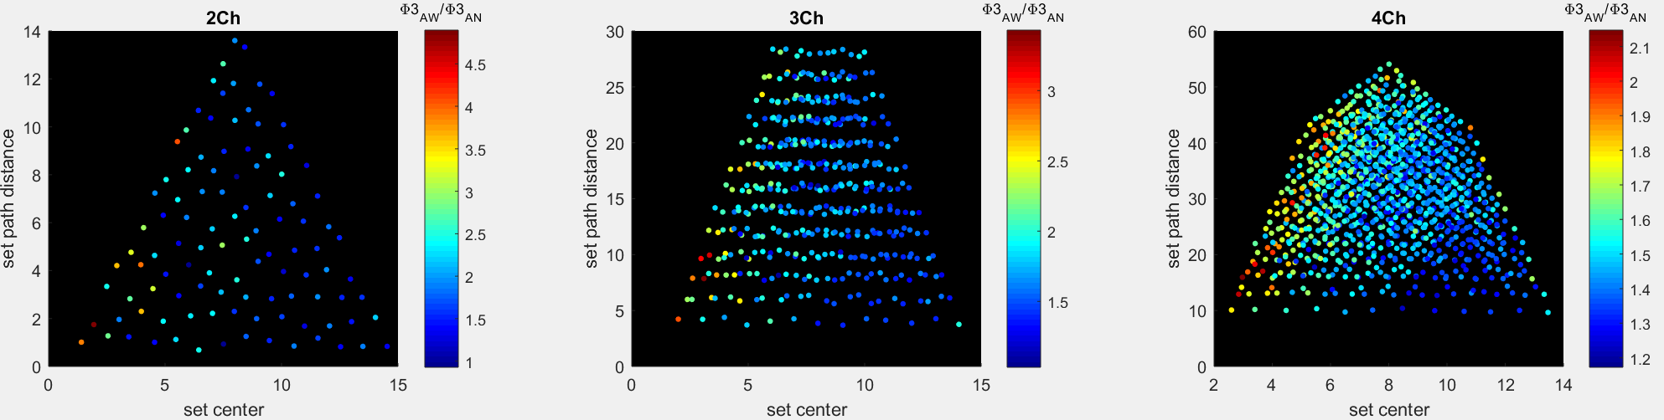
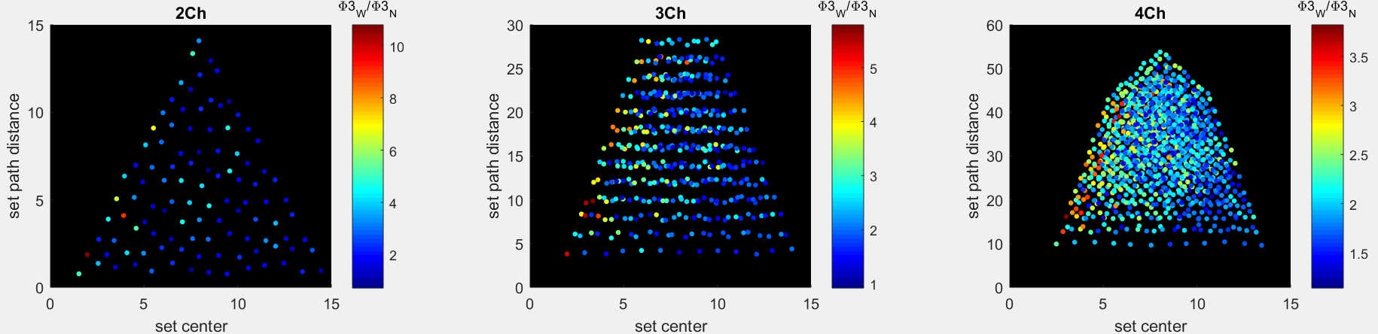
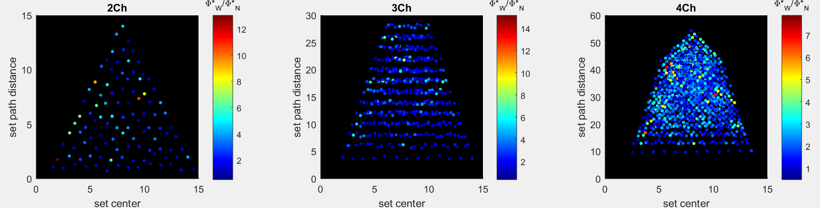
Phi3 within phi3 across phistar within phistar across
2ch
3ch
4ch
Notes:
Make for both magnitude and classification
Also, make for either 2.25s OR 18s TPM, columns are phi3-W phi3-A phistar-W phistar-A

Slide 4
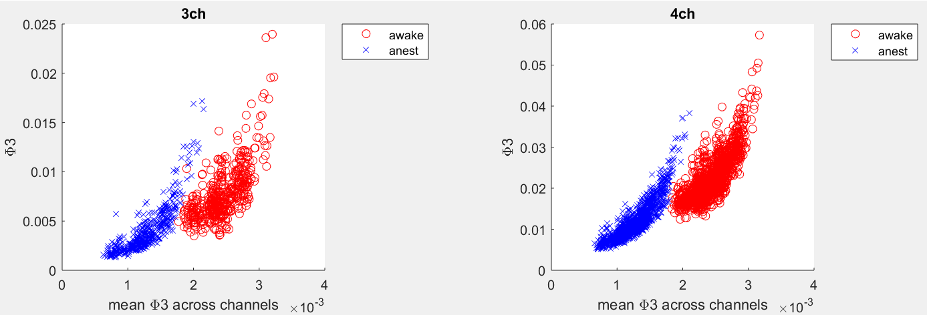
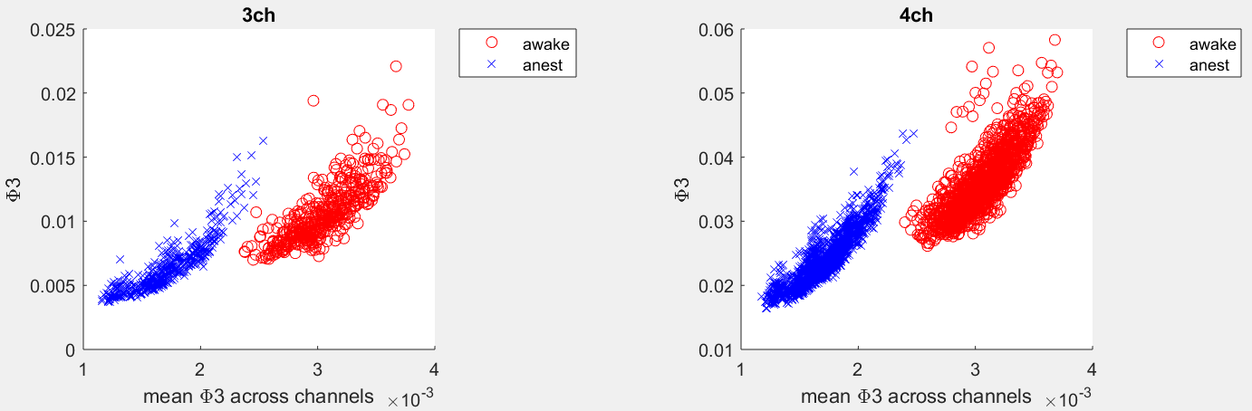
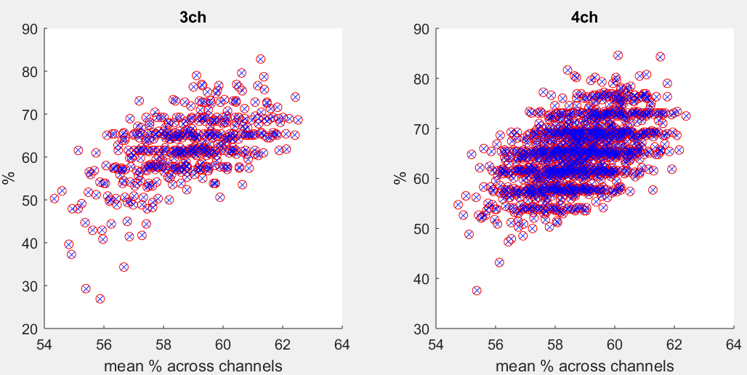
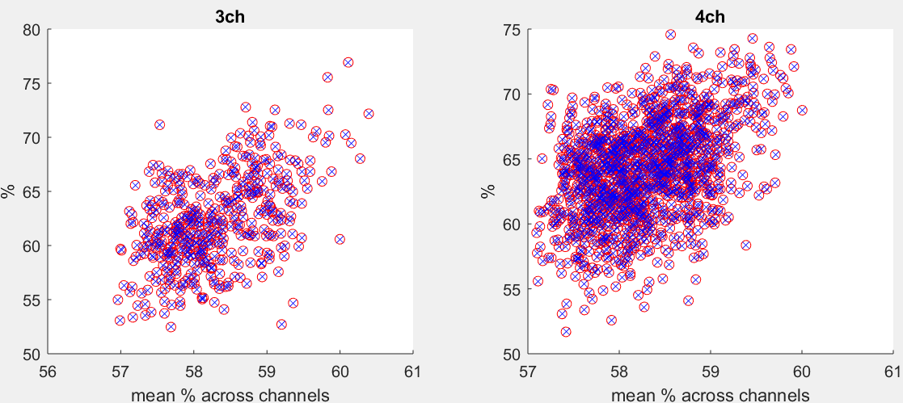
Notes:
8 panels for within flies
row 1 for magnitude: phi3-3ch phi3-4ch phistar-3ch phistar-4ch
row 2 for classification accuracy

Slide 5
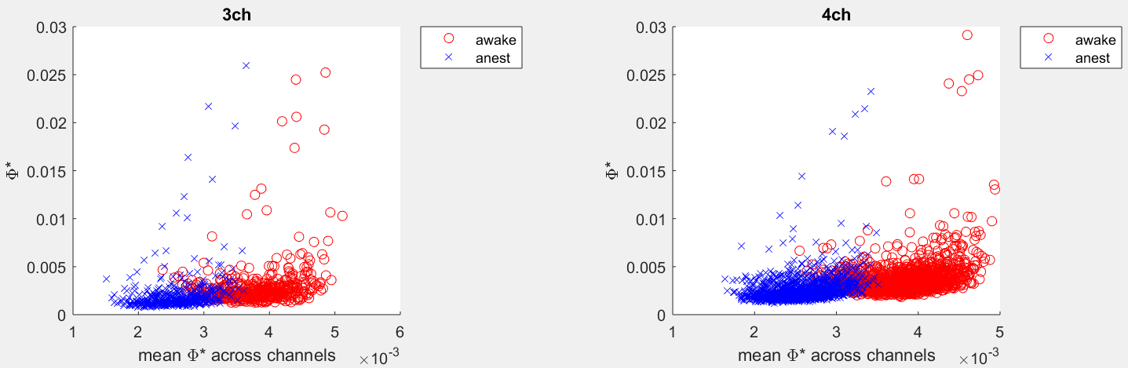
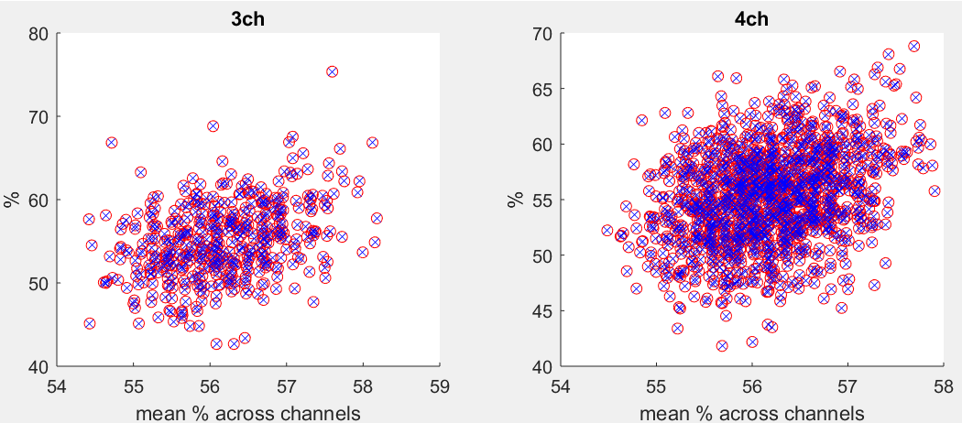
Notes:
8 panels for within flies
row 1 for magnitude: phi3-3ch phi3-4ch phistar-3ch phistar-4ch
row 2 for classification accuracy

Slide 6
Data Summary
N = 13 flies
15 channels per fly
1000 Hz sampling rate (downsampled)
2 conditions
8x2.25s trials awake
8x2.25s trials anaesthetised
Phi: tau=4ms

Slide 7
Analysis Summary
Leave-one-out (LOL) classification of conditions within fly across 2 conditions x 8 trials using
1-channel power
2-channel coherence
2-, 3-, 4-channel phi-3 and phi-star (2.25s TPM and covariance)
LOL classification of conditions across 2 conditions x 13 flies using
trial-averaged power
trial-averaged coherence
trial-averaged 2-, 3-, 4-channel phi-3 and phi-star (18s TPM and covariance)

Slide 8
Slides structure from here onwards
Power and coherence WITHIN flies
Power and coherence ACROSS flies
Phi-3 WITHIN flies
Phi-3 ACROSS flies
Phi-star WITHIN flies
Phi-star ACROSS flies

Slide 9
Power and Coherence Within Fly Analysis

Slide 10
Within Fly Analyses
Power and coherence calculated for each trial across 2.25s
Classification is across 2 conditions x 8 trials, within fly

Slide 11
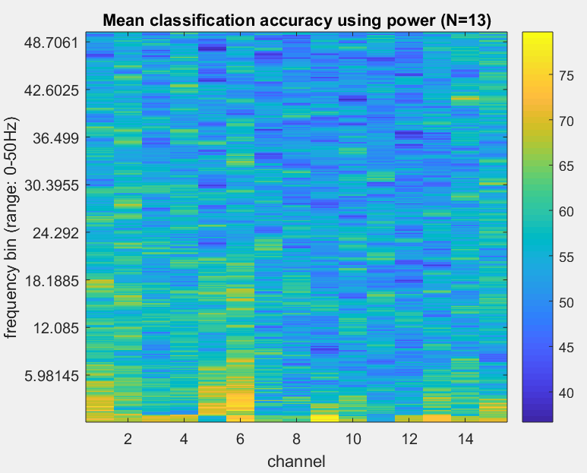
1-ch Power Classification
%
Power calculation:
3 tapers
frequency range 0-50Hz
padding = 1
Average across N=13 flies

Slide 12
Power Classification
Average across 13 flies
Standard error across 13 flies

Slide 13
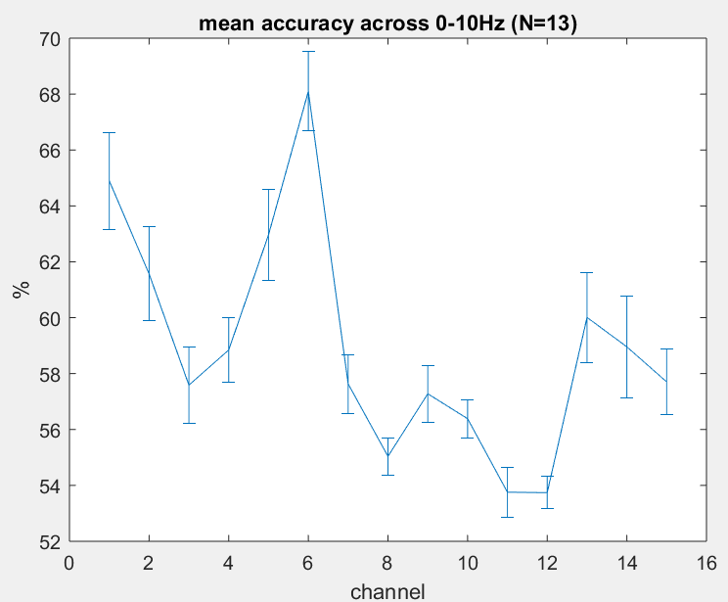
Power Classification Per Channel 0-10Hz

Slide 14
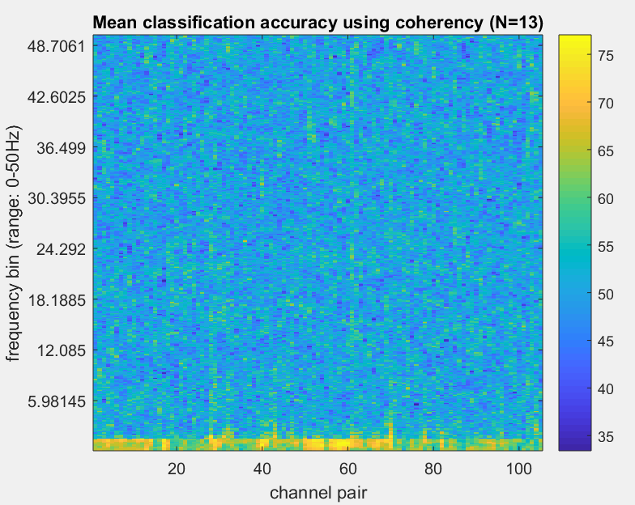
2-ch Coherence Classification
Coherence calculation
5 tapers
frequency range 0-50Hz
padding = 1
Average across N=13 flies

Slide 15
Coherence Classification
Average across 13 flies
Standard error across 13 flies

Slide 16
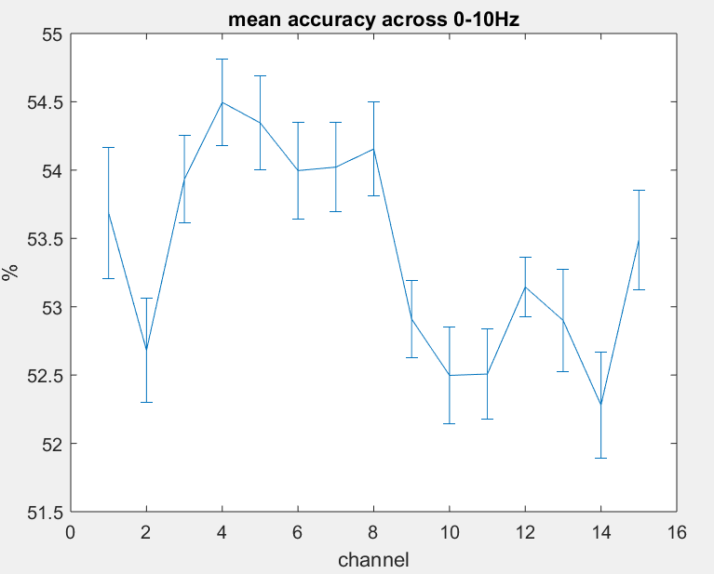
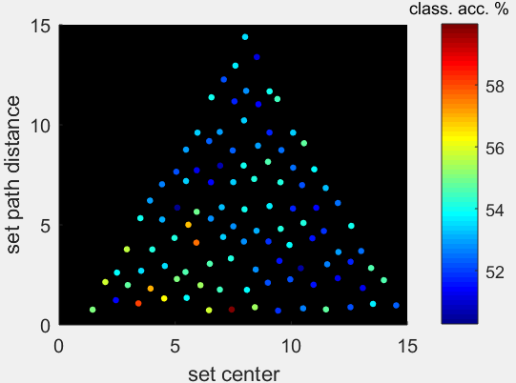
Coherence Classification Per Channel and Set Location (0-10Hz)
Value per channel = average value across all networks containing that channel
Notes:
Standard error of 13 flies

Slide 17
Power and Coherence Across Fly Analysis

Slide 18
Across Fly Analyses
Power and coherence averaged across trials (8 x 2.25s trials)
Will recompute for 18s for ‘fairer’ comparison with phi, later on
Classification is across 2 conditions x 13 flies

Slide 19
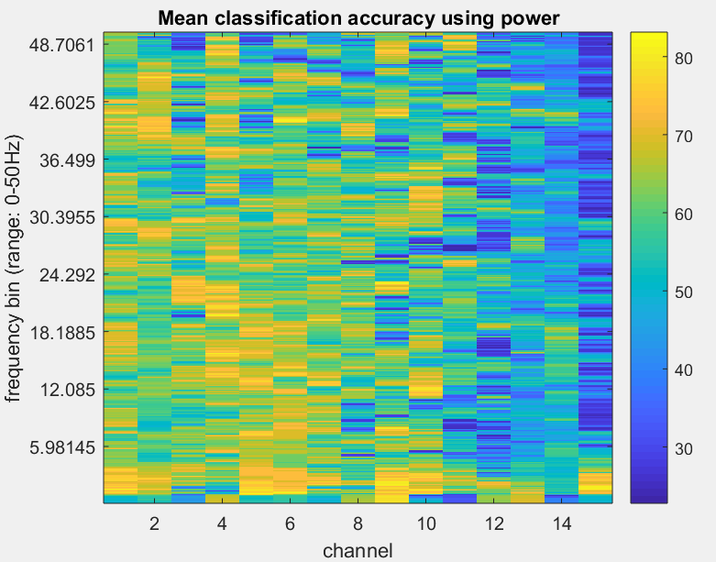
Power Classification

Slide 20
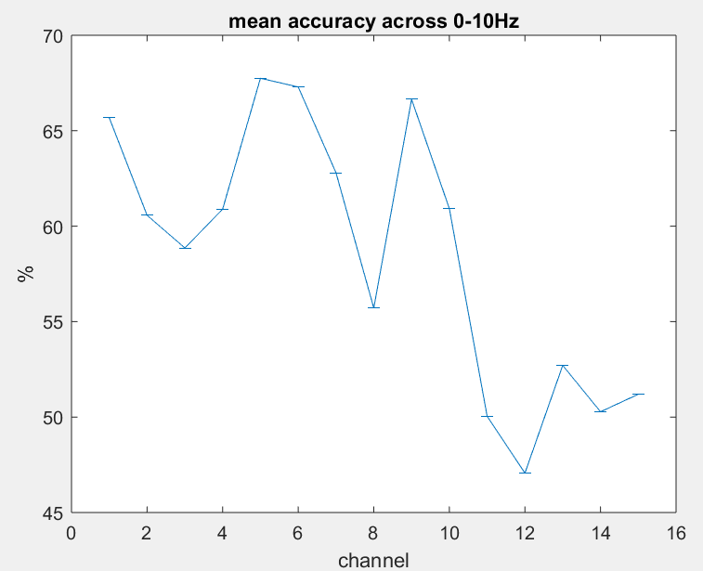
Power Classification Per Channel 0-10Hz

Slide 21
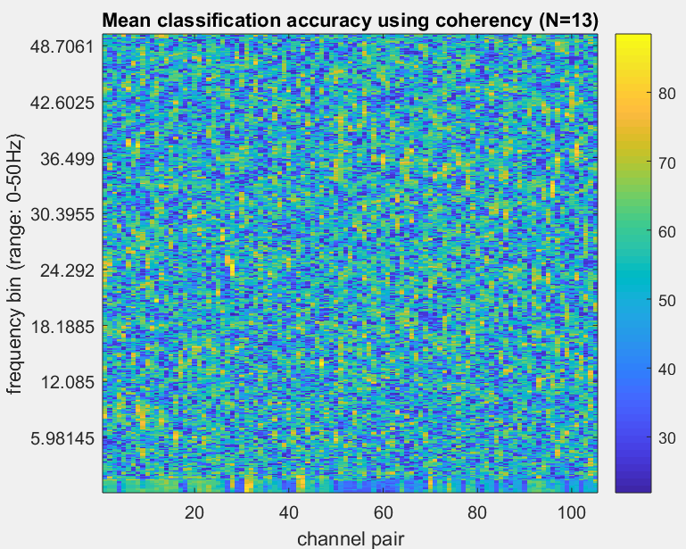
2-ch Coherence Classification

Slide 22
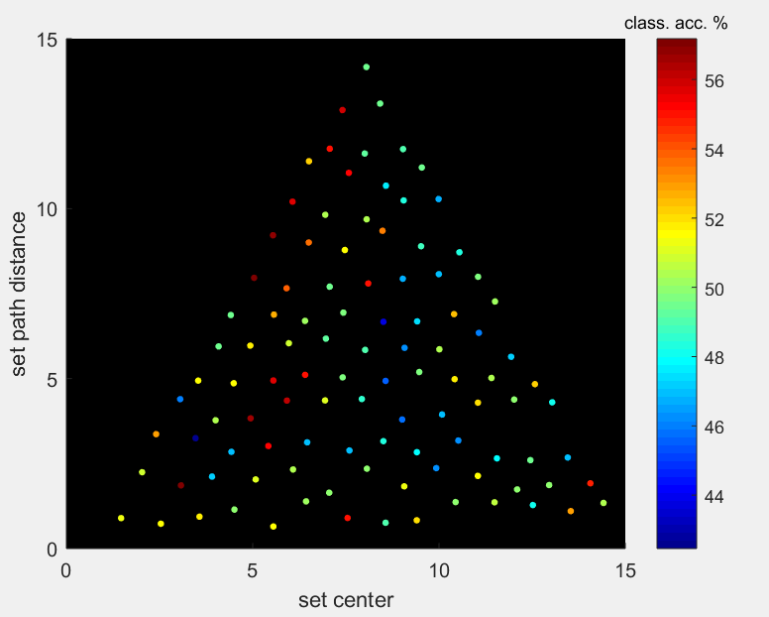
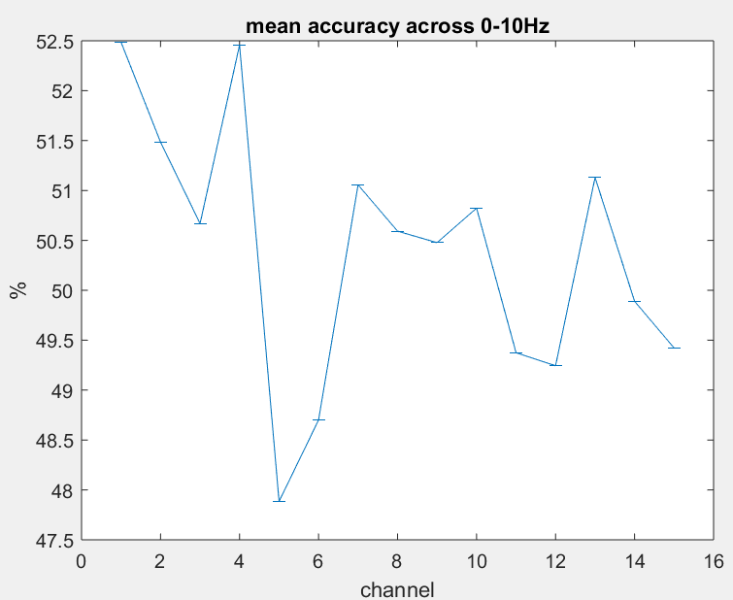
Coherence Classification Per Channel and Set Location (0-10Hz)

Slide 23
Phi-3 Within Fly Analysis

Slide 24
Within Fly Analysis
Phi-3 computed using 2 conditions x 8 trials x 2.25s TPMs
Classification is across 2 conditions x 8 trials, within fly

Slide 25
Mapping set location and globality to 2D
Goal – visualise phi-pattern in 2D space
But we have 2-, 3-, and 4-D spaces (for 2, 3, and 4 channel set combinations)
Reduction to 2 dimensions:
Location – where is the center of the set?
‘set center’
Globality – how far apart are the channels in the set?
‘set path distance’

Slide 26
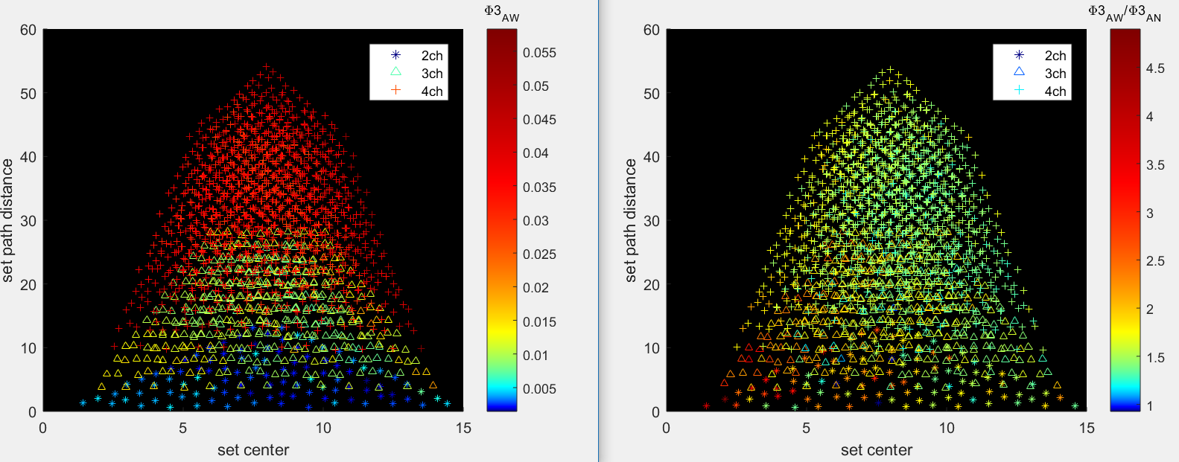
Phi-3 values using 2.25s TPM
Awake
Awake/Anest
Note: (x, y) are jittered by +-~.4 of minimum change in axis; this is due to multiple sets having the same position
Notes:
NOTE: Color axis is non-linear
NOTE: (x,y) locations (for all of these plots) are jittered randomly because some channel sets share the same (x,y) location
Jitter is just under half of the smallest step from one value to the next (+-0.1 [0.25/2] center and +-0.4 [1/2] for distance)
Averaged across 8 trials and 13 flies

Slide 27
Phi-3 values using 2.25s TPM
Awake/Anest
Distance: r = -.07, p = .5
Center: r = -.55, p << .001
Distance: r = .00, p = .98
Center: r = -.57, p << .001
Distance: r = .16, p << .001
Center: r = -.51, p << .001
Notes:
Color scale here is now linear
<< means more than an order of magnitude, i.e. .0001 or less

Slide 28
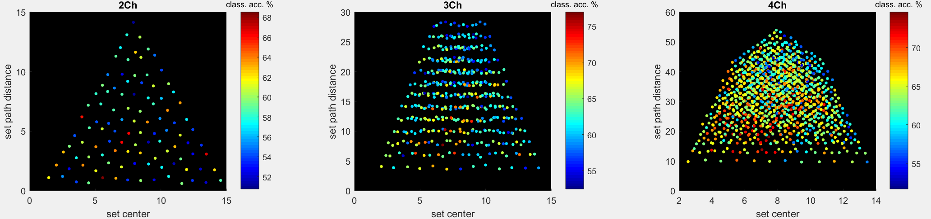
Classification using 2.25s TPM Phi-3
Leave-one-out classification across 8+8 (awake+anest) trials
Distance: r = -.09, p = .36
Center: r = -.17, p = .08
Distance: r = -.32, p << .001
Center: r = -.14, p = .002
Distance: r = -.23, p << .001
Center: r = -.20, p << .001
Notes:
Color scale here is now linear
Looks like higher accuracy in the middle? (Where the set center is between the periphery and center)
Not sure how to investigate this

Slide 29
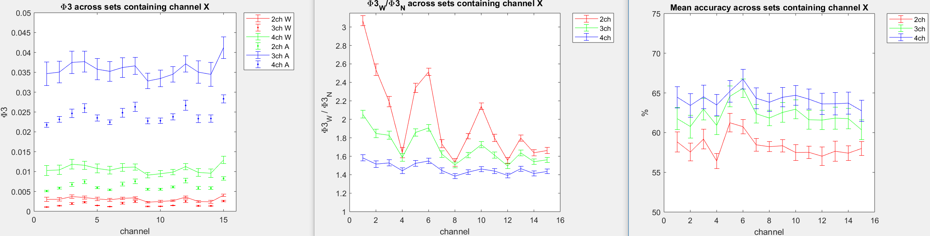
Phi-3 values and classification per channel
Notes:
Per-channel values are obtained by averaging across all channel sets in which the channel is contained
Averaged across trials, then across flies
Bars are standard error across 13 flies
Despite larger relative change between conditions, accuracy is lower for 2ch – suggests change per channel in phi is less consistent across networks within fly?

Slide 30
Phi-3 vs average of 2-ch means
W: r = .80, p << .001
A: r = .88, p << .001
W: r = .81, p << .001
A: r = .90, p << .001
Notes:
Looks like channels which contribute to phi in small networks are good for larger networks also
x-axis: each channel has an average phi value (across all networks it’s involved in, see previous slide) – x value is obtained by averaging the channel averages across channels in the channel set
y-axis: actual phi value for the channel set

Slide 31
Phi-3 classification vs 2-ch means
r = .50, p << .001
r = .42, p << .001
Notes:
Looks like channels which can be used to discriminate wake/anest are also good in larger networks

Slide 32
Phi-3 Across Fly Analysis

Slide 33
Across Fly Analysis
Phi-3 computed using 2 conditions x 18s TPMs
Classification is across 2 conditions x 13 flies

Slide 34
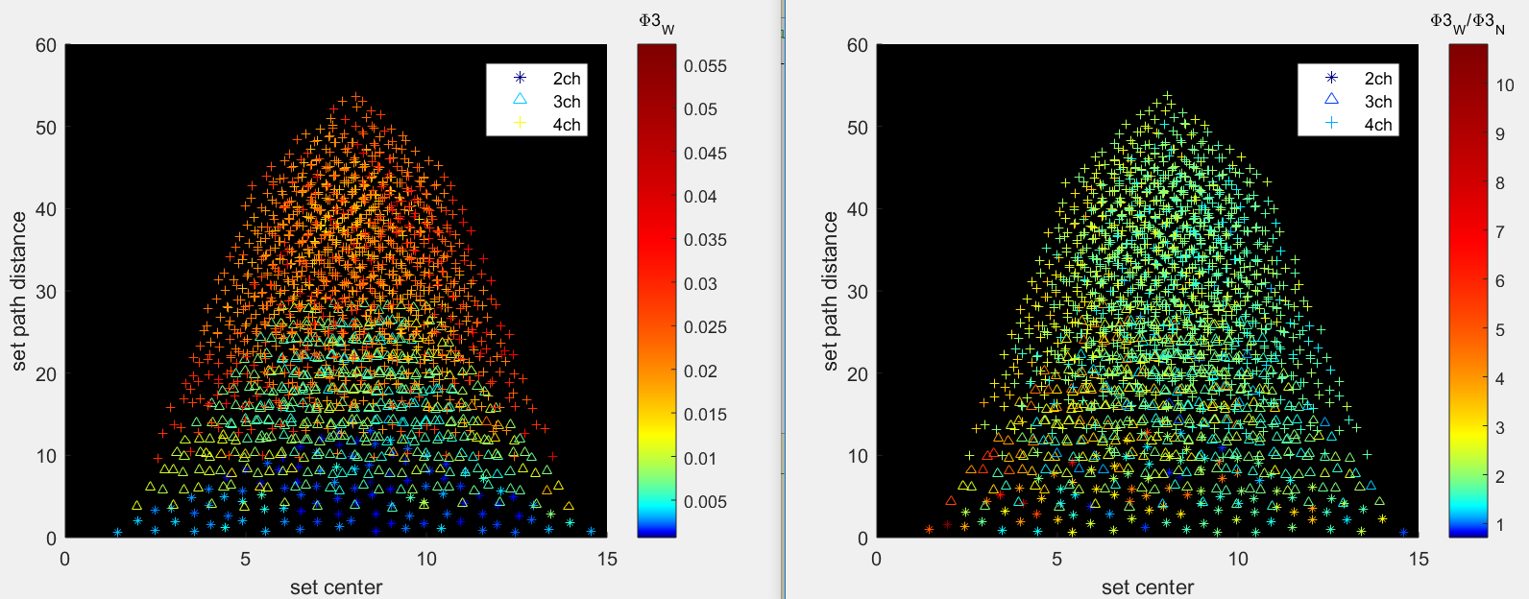
Phi-3 values using 18s TPM
Awake
Awake/Anest
Note: (x, y) are jittered by +-~.4 of minimum change in axis; this is due to multiple sets having the same position
Notes:
NOTE: Color axis is non-linear
NOTE: (x,y) locations (for all of these plots) are jittered randomly because some channel sets share the same (x,y) location
Jitter is just under half of the smallest step from one value to the next (+-0.1 [0.25/2] center and +-0.4 [1/2] for distance)
Averaged across 8 trials and 13 flies

Slide 35
Phi-3 values using 18s TPM
Awake/Anest
Distance: r = -.01, p = .90
Center: r = -.41, p << .001
Distance: r = .05, p = .26
Center: r = -.43, p << .001
Distance: r = .07, p = .01
Center: r = -.39, p << .001
Notes:
Color scale here is now linear
<< means more than an order of magnitude, i.e. .0001 or less

Slide 36
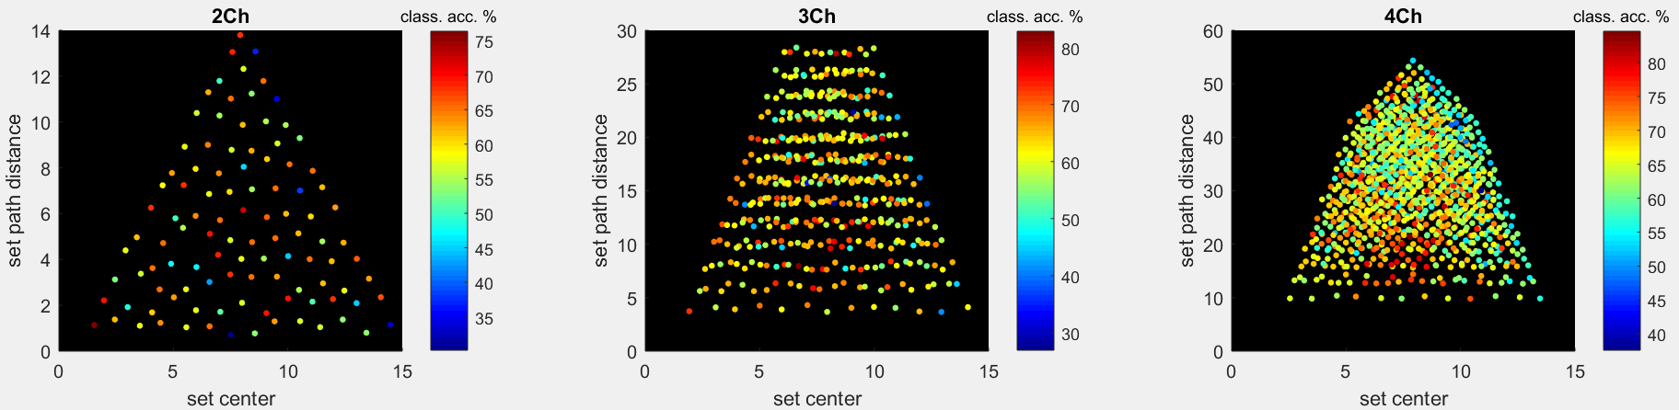
Classification values using 18s TPM
Awake/Anest
Distance: r = -.01, p = .94
Center: r = -.14, p = .15
Distance: r = -.10, p = .03
Center: r = -.13, p = .005
Distance: r = .18, p << .001
Center: r = -.21, p << .001
Notes:
Color scale here is now linear

Slide 37
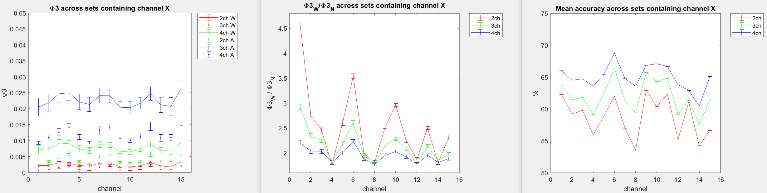
Phi-3 values and classification per channel
Notes:
Averaged across trials, then across flies
Bars are standard error across 13 flies
Despite larger relative change between conditions, accuracy is lower for 2ch – suggests change per channel in phi is less consistent across networks within fly?
Errorbars in bottom right are 0 – because we are classifying across 13 flies

Slide 38
Phi-3 vs average of 2-ch means
W: r = .68, p << .001
A: r = .83, p << .001
W: r = .79, p << .001
A: r = .88, p << .001
Notes:
Looks like channels which contribute to phi in small networks are good for larger networks also

Slide 39
Phi-3 classification vs 2-ch means
r = .57, p << .001
r = .51, p << .001
Notes:
Looks like channels which can be used to discriminate wake/anest are also good in larger networks

Slide 40
Phi-star Within Fly Analysis

Slide 41
Within Fly Analysis
Phi-star computed using 2 conditions x 8 trials x 2.25s covariances
Classification is across 2 conditions x 8 trials, within fly

Slide 42
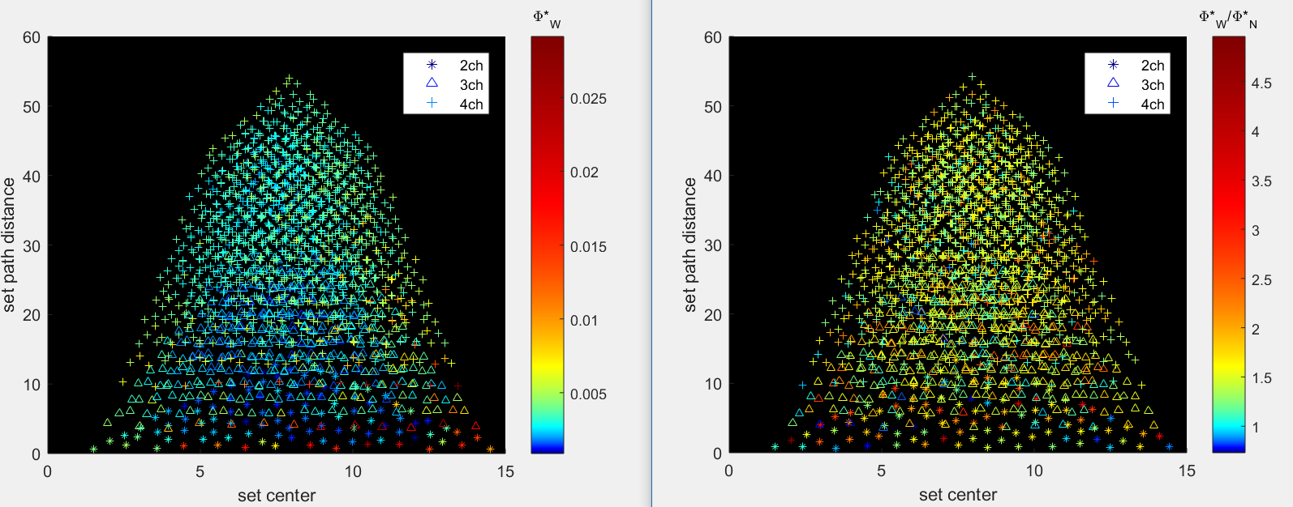
Phi-star values using 2.25s TPM
Awake
Awake/Anest
Note: (x, y) are jittered by +-~.4 of minimum change in axis; this is due to multiple sets having the same position
Notes:
NOTE: Color axis is non-linear
NOTE: (x,y) locations (for all of these plots) are jittered randomly because some channel sets share the same (x,y) location
Jitter is just under half of the smallest step from one value to the next (+-0.1 [0.25/2] center and +-0.4 [1/2] for distance)
Averaged across 8 trials and 13 flies

Slide 43
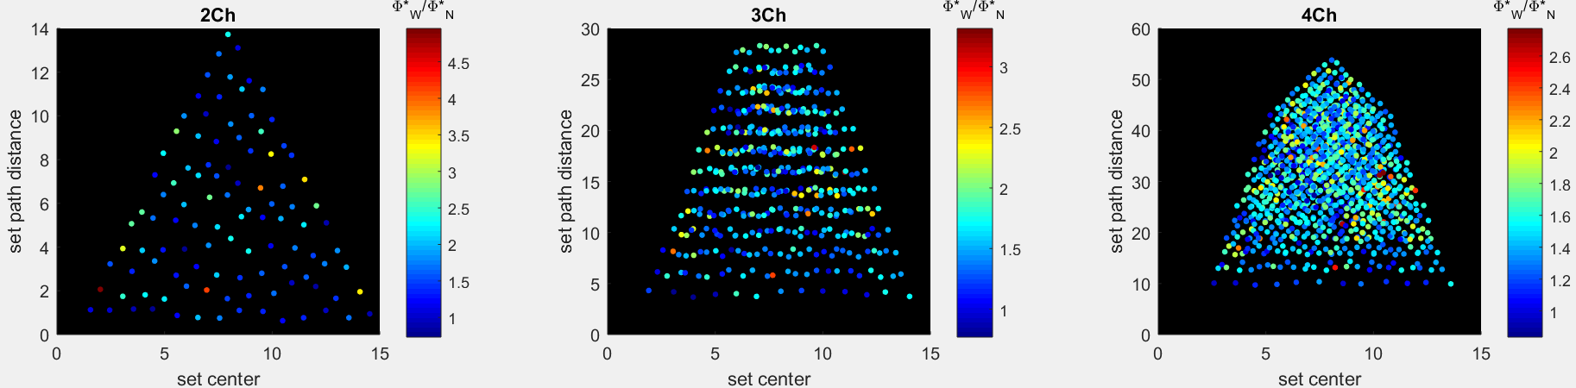
Phi-star values using 2.25s TPM
Awake/Anest
Distance: r = .04, p = .65
Center: r = -.12, p = .23
Distance: r = .10, p = .03
Center: r = .05, p = .31
Distance: r = .06, p = .02
Center: r = .08, p = .004
Notes:
Color scale here is now linear
<< means more than an order of magnitude, i.e. .0001 or less

Slide 44
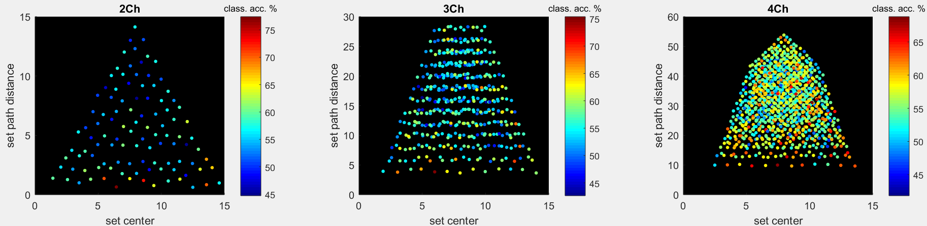
Classification using 2.25s TPM Phi-star
Leave-one-out classification across 8+8 (awake+anest) trials
Distance: r = -.41, p << .001
Center: r = .12, p = .21
Distance: r = -.22, p << .001
Center: r = .06, p = .23
Distance: r = -.14, p << .001
Center: r = .04, p = .10
Notes:
Color scale here is now linear
Looks like higher accuracy in the middle? (Where the set center is between the periphery and center)
Not sure how to investigate this

Slide 45
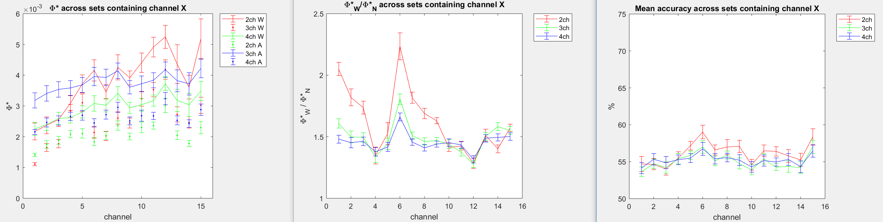
Phi-star values and classification per channel
Notes:
Averaged across trials, then across flies
Bars are standard error across 13 flies
Phi axis is smaller for phi-star than for phi-3

Slide 46
Phi-star vs average of 2-ch means
W: r = .26, p << .001
A: r = .26, p << .001
W: r = .29, p << .001
A: r = .28, p << .001
Notes:
Looks like channels which contribute to phi in small networks are good for larger networks also

Slide 47
Phi-star classification vs 2-ch means
r = .36, p << .001
r = .31, p << .001
Notes:
Looks like channels which can be used to discriminate wake/anest are also good in larger networks

Slide 48
Phi-star Across Fly Analysis

Slide 49
Across Fly Analysis
Phi-star computed using 2 conditions x 18s covariances
Classification is across 2 conditions x 13 flies

Slide 50
Phi-star values using 2.25s TPM
Awake/Anest
Distance: r = .15, p = .11
Center: r = -.24, p = .01
Distance: r = .19, p << .001
Center: r = -.12, p = .03
Distance: r = .17, p << .001
Center: r = -.05, p = .04
Notes:
Color scale here is now linear
<< means more than an order of magnitude, i.e. .0001 or less

Slide 51
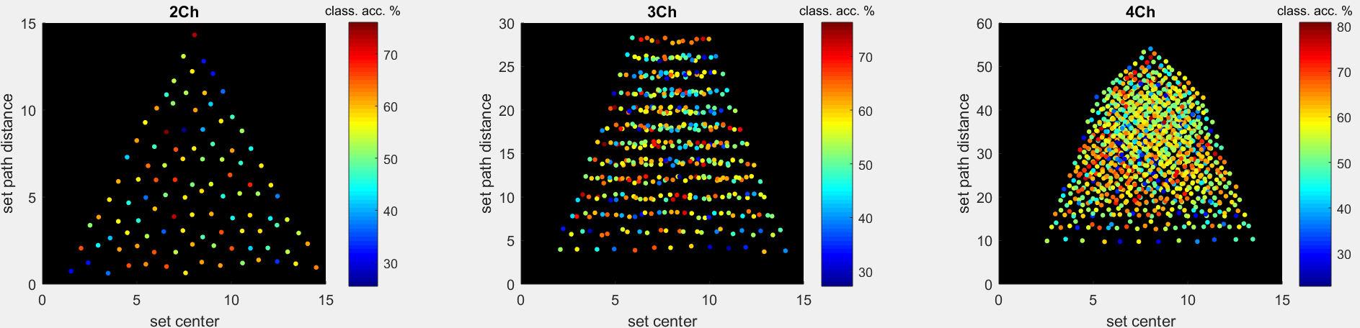
Classification using 2.25s TPM Phi-star
Leave-one-out classification across 8+8 (awake+anest) trials
Distance: r = -.08, p .44
Center: r = .01, p = .90
Distance: r = -.04, p = .43
Center: r = -.10, p = .03
Distance: r = -.00, p = .96
Center: r = -.07, p = .01
Notes:
Color scale here is now linear
Looks like higher accuracy in the middle? (Where the set center is between the periphery and center)
Not sure how to investigate this

Slide 52
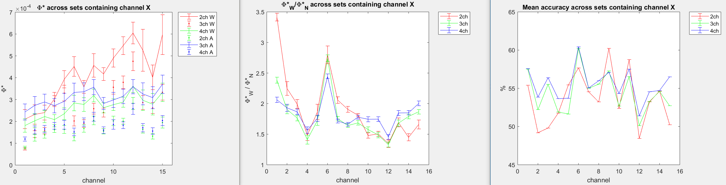
Phi-star values and classification per channel
Notes:
Averaged across trials, then across flies
Bars are standard error across 13 flies
Phi axis is smaller for phi-star than for phi-3
Errorbars in bottom right are 0 – because we are classifying across 13 flies

Slide 53
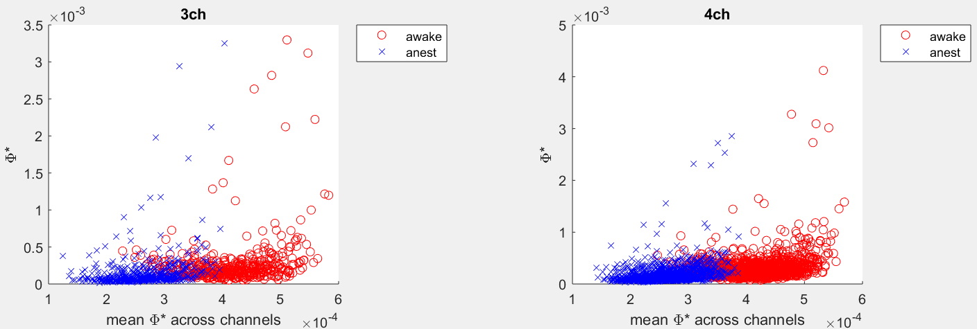
Phi-star vs average of 2-ch means
W: r = .25, p << .001
A: r = .26, p << .001
W: r = .25, p << .001
A: r = .27, p << .001
Notes:
Looks like channels which contribute to phi in small networks are good for larger networks also

Slide 54
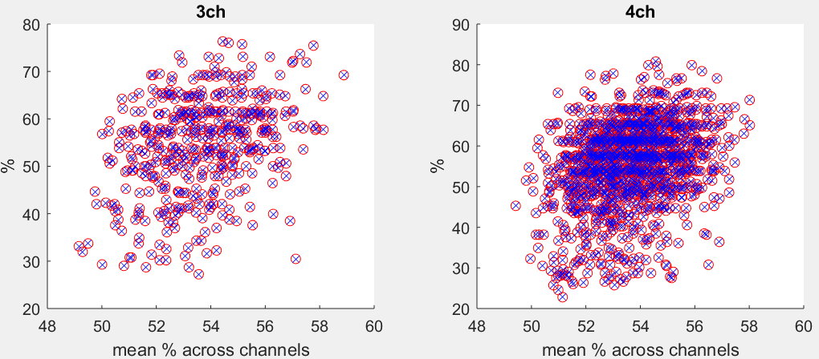
Phi-star classification vs 2-ch means
r = .34, p << .001
r = .30, p << .001
Notes:
Looks like channels which can be used to discriminate wake/anest are also good in larger networks

